Slide 1
Chapter 3
Transformation

Slide 2
Transformation:
What is transformations?
  The geometrical changes of an object from a current state to modified state.
In 2D graphics, Transformations can be represented by 2x2 matrices. Most common transformations such as Translation, rotation, scaling, shearing, and reflection are linear transformations and can be represented in the 2x2 matrix.

Slide 3
Translation
A translation moves an object to a different position on the screen. You can translate a point in 2D by adding translation coordinate (tx, ty) to the original coordinate (X, Y) to get the new coordinate (X’, Y’).

Slide 4
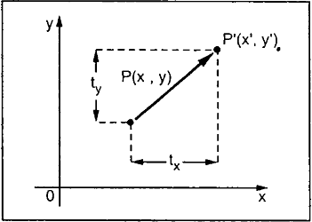
Translation
From this figure, you can write that:
X’ = X + tx
Y’ = Y + ty
The pair (tx, ty) is called the translation vector or shift vector.

Slide 5

Rotation
For rotation by an angle θ clockwise about the origin, the functional form is
x' = xcosθ + ysinθ and
y' = − xsinθ + ycosθ.
Written in matrix form, this becomes:

Slide 6

Rotation
Similarly, for a rotation counterclockwise about the origin, the functional form is and and the matrix form is:

Slide 7
Scaling
To change the size of an object, scaling transformation is used.
In the scaling process, you either expand or compress the dimensions of the object.
Scaling can be achieved by multiplying the original coordinates of the object with the scaling factor to get the desired result.

Slide 8
Scaling
Let us assume that the original coordinates are (X, Y), the scaling factors are (SX, SY), and the produced coordinates are (X’, Y’).
This can be mathematically represented as shown below:
X’ = X * SX and Y’ = Y * SY

Slide 9
Shearing
A transformation that slants the shape of an object is called the shear transformation.
There are two shear transformations X-Shear and Y-Shear. One shifts X coordinates values and other shifts Y coordinate values.
However, in both the cases, only one coordinate changes its coordinates and other preserves its values.
Shearing is also termed as Skewing.

Slide 10
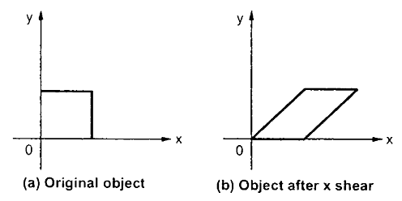
X-Shear
The X-Shear preserves the Y coordinate and changes are made to X coordinates, which causes the vertical lines to tilt right or left as shown in below figure.
The transformation matrix for X-Shear can be represented as:
X’ = X + Shx ∙ Y
Y’ = Y

Slide 11
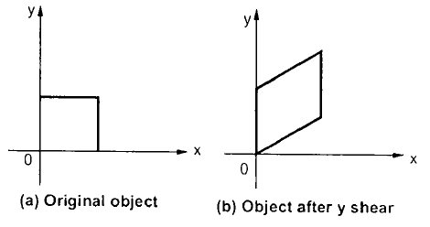
Y shear
The Y-Shear preserves the X coordinates and changes the Y coordinates which causes the horizontal lines to transform into lines which slopes up or down as shown in the following figure.
The Y-Shear can be represented in matrix from as:
Y’ = Y + Shy ∙ X
X’ = X

Slide 12
Reflection
Reflection is the mirror image of original object.
In other words, we can say that it is a rotation operation with 180˚.
In reflection transformation, the size of the object does not change.

Slide 13
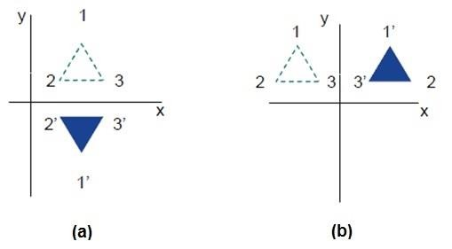
Reflection

Slide 14
Thank you….

